Slide 1
Outline
Introduction to OpenDroneMap
Break
Using OpenDroneMap
Break
Using Data from OpenDroneMap
http://tinyurl.com/odm-inaware

Slide 2

Stephen Mather, GIS Manager, Cleveland Metroparks
@smathermather, svm@clevelandmetroparks.com
Dakota Benjamin, Geospatial Developer, Cleveland Metroparks
dmb2@clevelandmetroparks.com
http://tinyurl.com/odm-inaware

Slide 3
OpenDroneMap is an open source toolkit for aerial drone imagery.
It is modern photogrammetry - fully automated matching, digital surface modeling, and mosaicking

Slide 4
https://tinyurl.com/opendronemap

Slide 5
OpenDroneMap is an open source toolkit for aerial drone imagery.
It is modern photogrammetry - fully automated matching, digital surface modelling, and mosaicking
Platform vs. Toolkit

Slide 6
Origins
Computer Vision
Photogrammetry
Notes:
OpenDroneMap originates from Computer Vision, i.e. how do we enable computers to navigate and understand the world.
It depends on stereo vision much like we do to make sense of the world in 3D

Slide 7
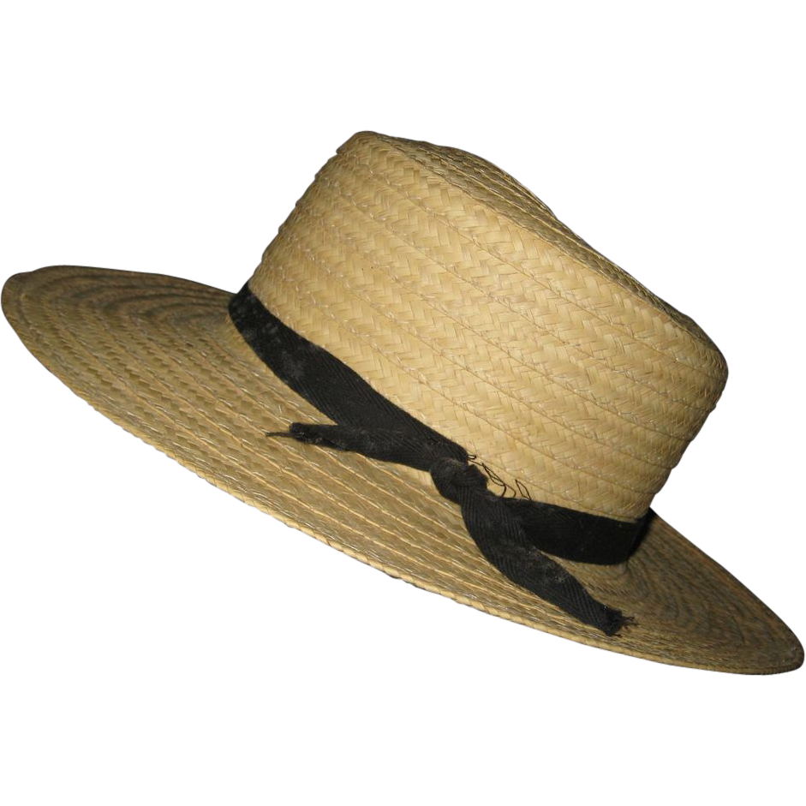
Purposes
Ecology
Humanitarian
Participatory creation of data for the public good
http://image0-rubylane.s3.amazonaws.com/shops/suzanstreasures/VCx20-x201402.1L.jpg
Notes:
OpenDroneMap originates from Computer Vision, i.e. how do we enable computers to navigate and understand the world.
It depends on stereo vision much like we do to make sense of the world in 3D

Slide 8
ODM and the photogrammetric process
Structure from Motion
Point Cloud Densification
Poisson Surface Reconstruction
Multi-View Stereo Texturing
Orthophoto Generation

Slide 9
ODM and the photogrammetric process
Structure from Motion
Point Cloud Densification
Poisson Surface Reconstruction
Multi-View Stereo Texturing
Orthophoto Generation

Slide 10
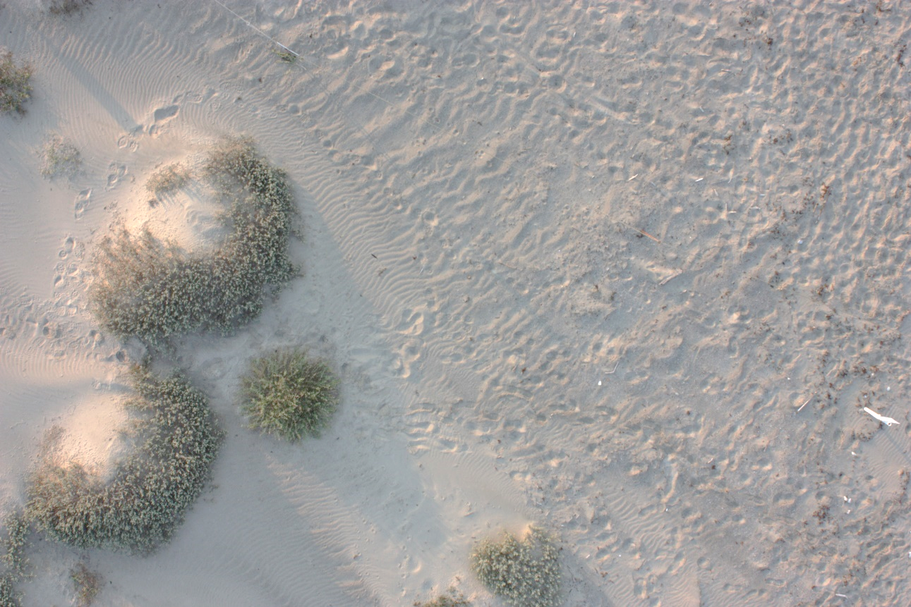
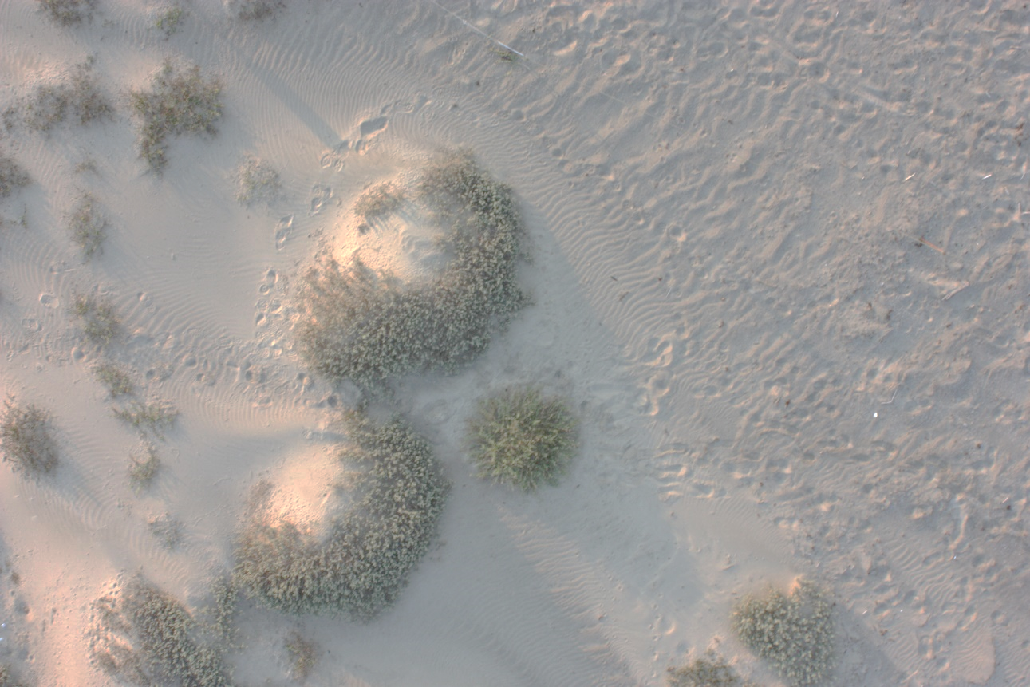
Structure from Motion
Matches features extracted from images with overlap
Credit: Michelle Tobias

Slide 11
Photogrammetry Process
Structure from Motion
Point Cloud Densification
Poisson Surface Reconstruction
Multi-View Stereo Texturing
Orthophoto Generation

Slide 12
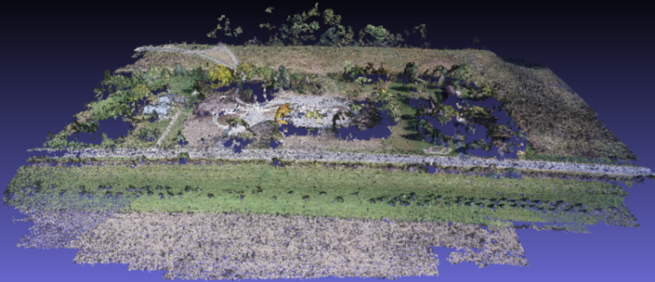
Point Cloud from Matching
Notes:
(Photogrammetrically Derived Point Cloud)

Slide 13
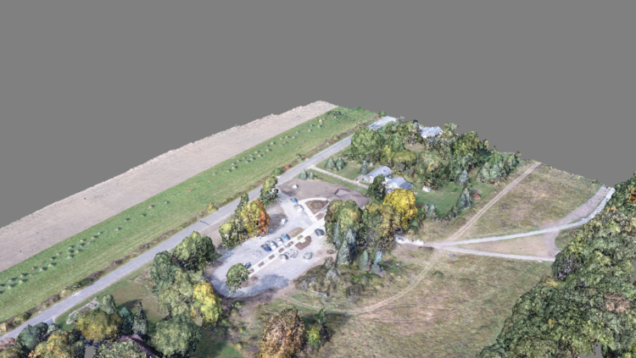
Dense Point Cloud from finding all matches

Slide 14
Photogrammetry Process
Structure from Motion
Point Cloud Densification
Poisson Surface Reconstruction
Multi-View Stereo Texturing
Orthophoto Generation

Slide 15
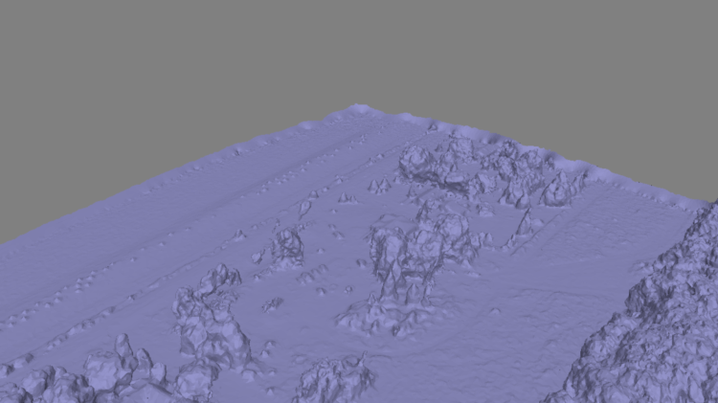
Mesh
Notes:
Uses the Point Cloud Library (PCL), followed by mesh decimation

Slide 16
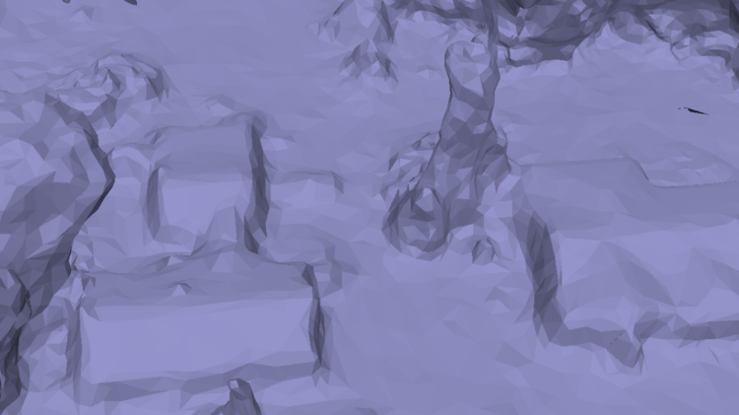
Mesh
Notes:
Uses the Point Cloud Library (PCL), followed by mesh decimation

Slide 17
Photogrammetry Process
Structure from Motion
Point Cloud Densification
Poisson Surface Reconstruction
Multi-View Stereo Texturing
Orthophoto Generation

Slide 18
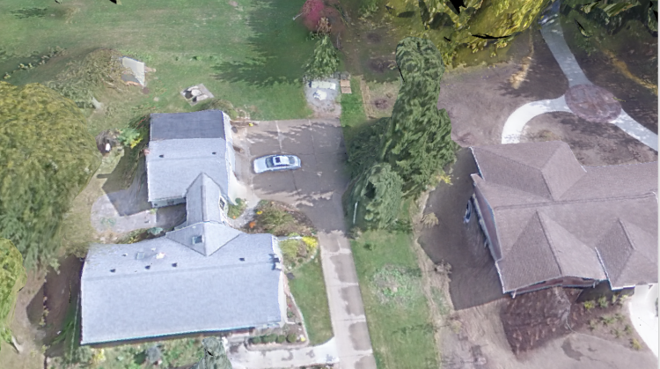
Texturing

Slide 19
Photogrammetry Process
Structure from Motion
Point Cloud Densification
Poisson Surface Reconstruction
Multi-View Stereo Texturing
Orthophoto Generation

Slide 20
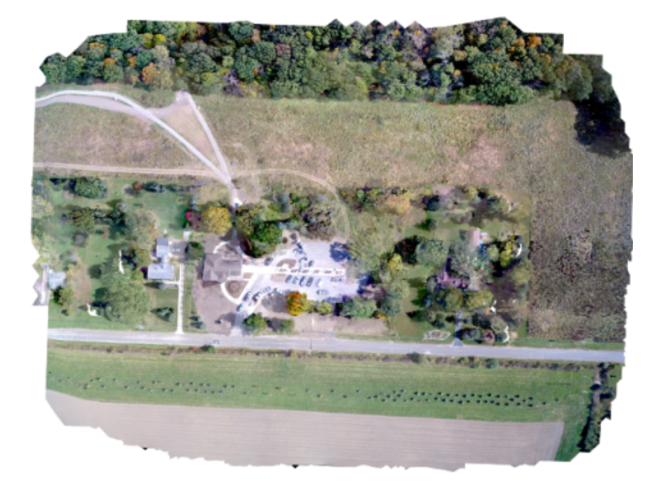
Orthophoto Generation

Slide 21
How to Use OpenDroneMap

Slide 22
Usage
Command line tool
Portable OpenStreetMap (POSM)
WebODM
API
API Docs: https://opendronemap.github.io/WebODM/

Slide 23
Installation
There are many ways to install ODM:
Natively using Ubuntu 14.04 or later (or with Virtual Machine via vagrant)
Linux, MacOS or Windows, by installing Docker
Via the above methods but with a Web-based GUI called WebODM

Slide 24
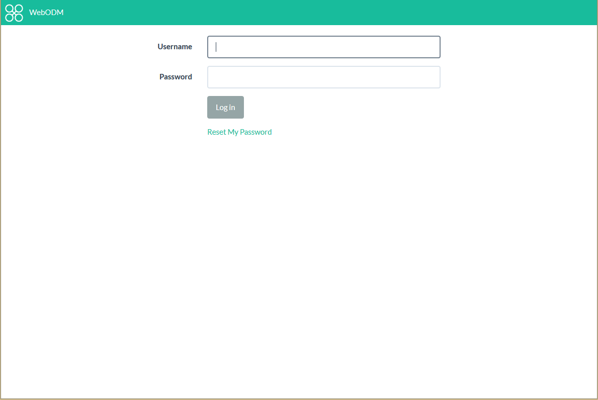

Slide 25
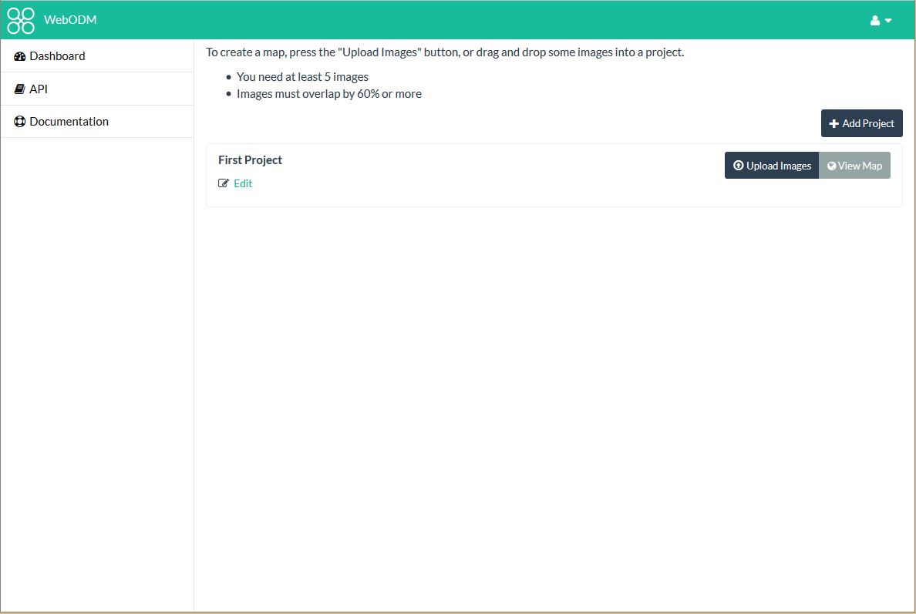

Slide 26
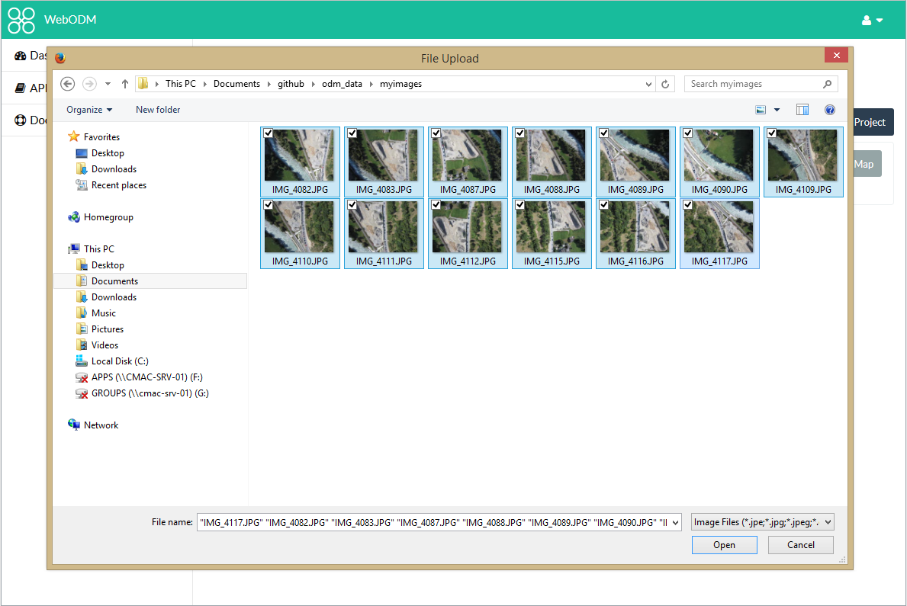

Slide 27
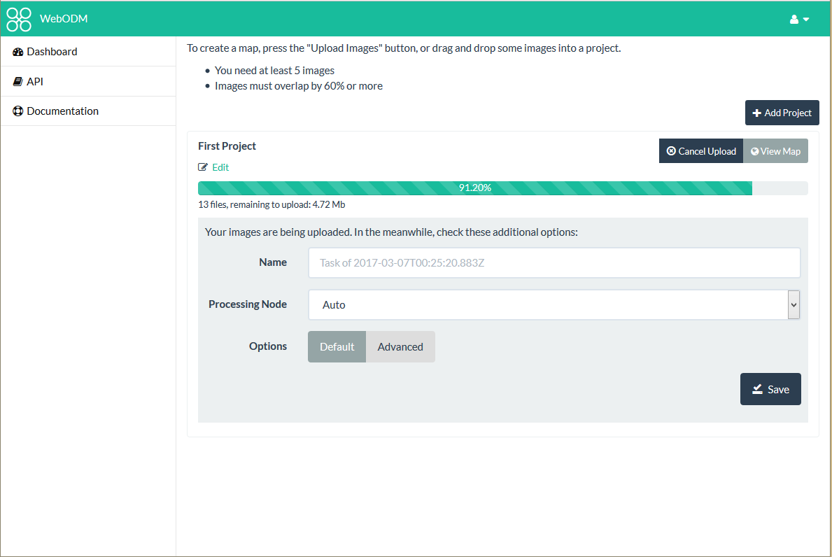

Slide 28
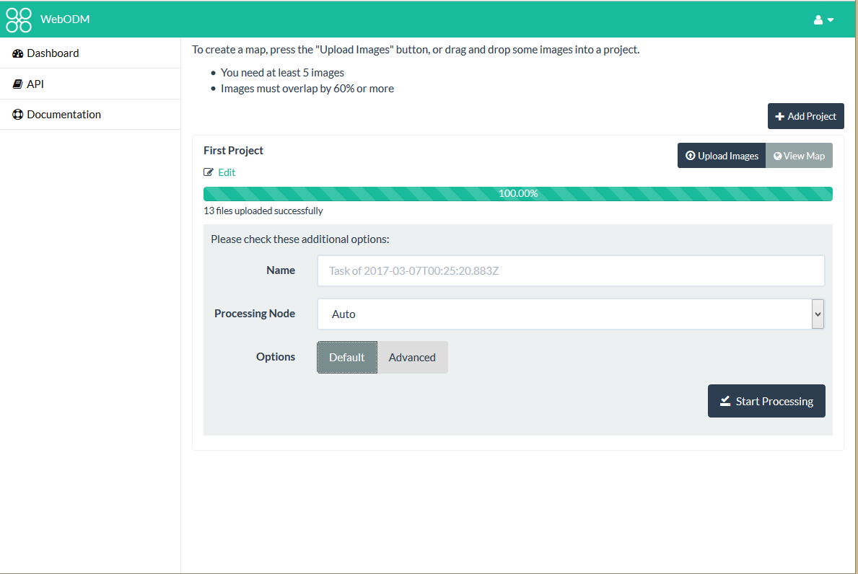

Slide 29
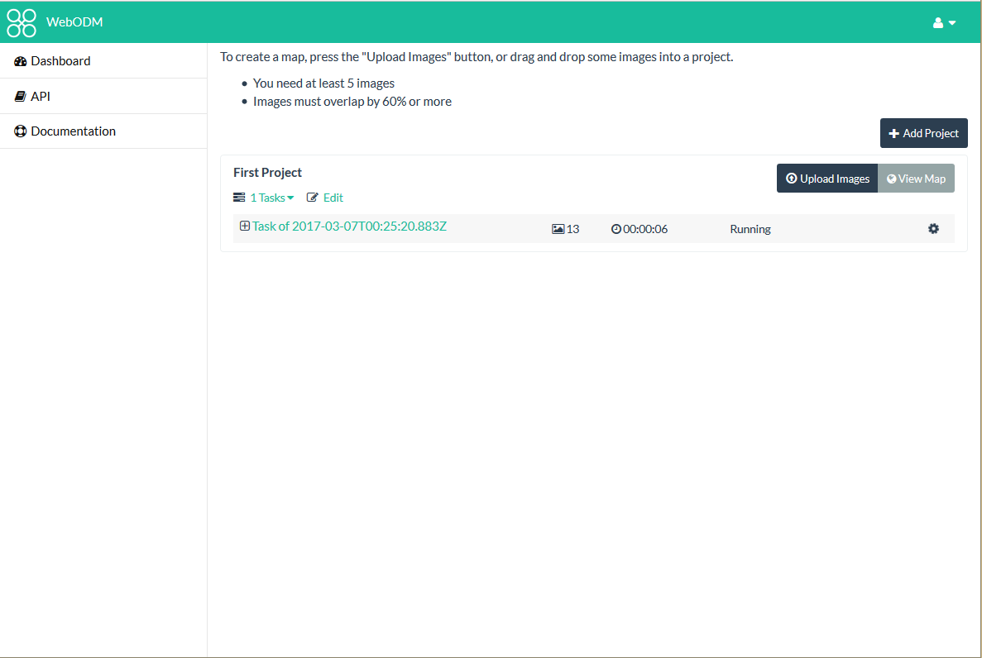

Slide 30
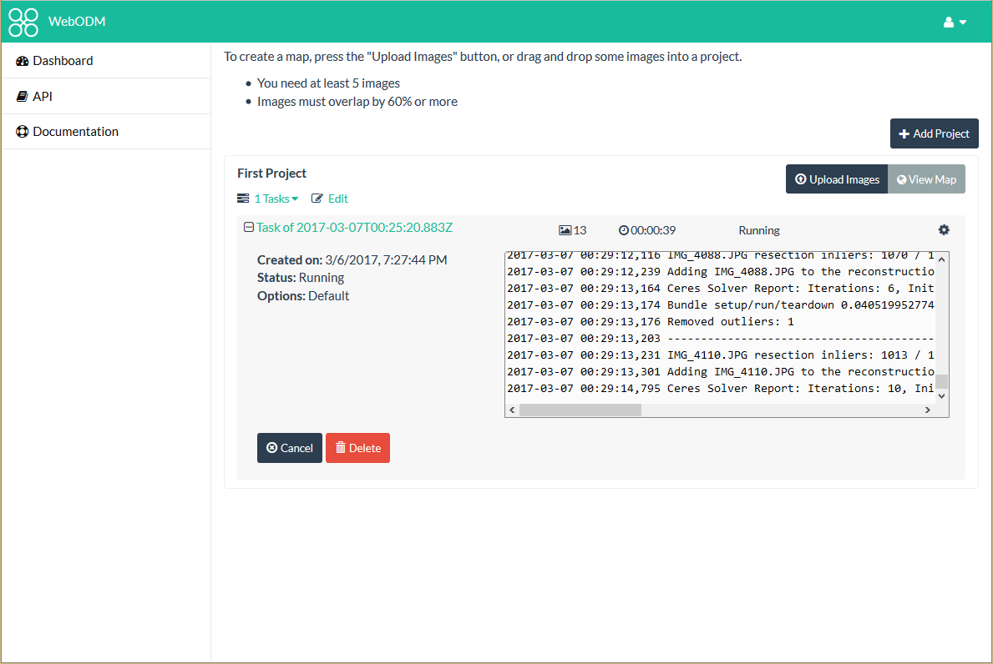

Slide 31
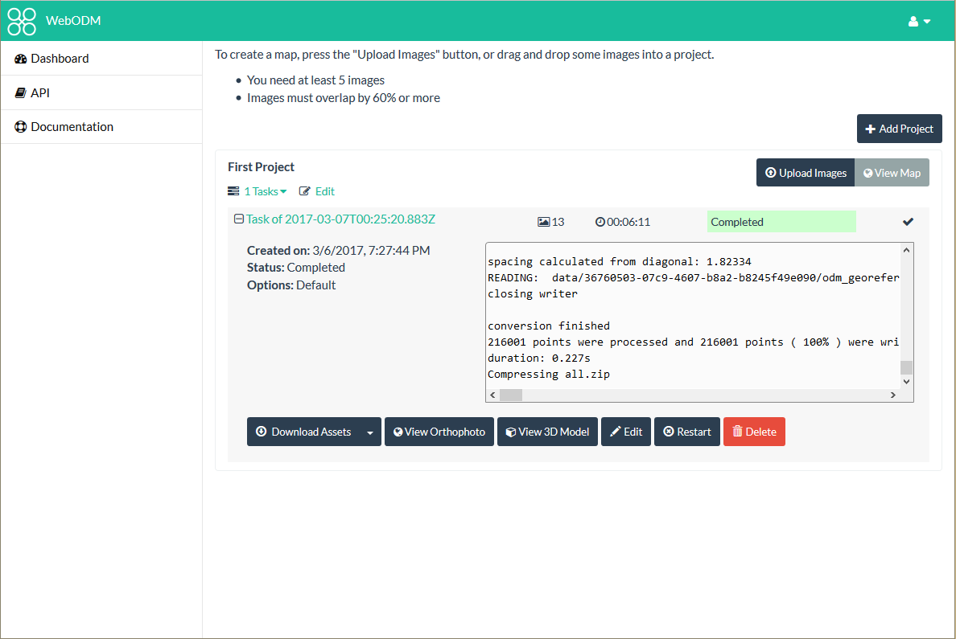

Slide 32
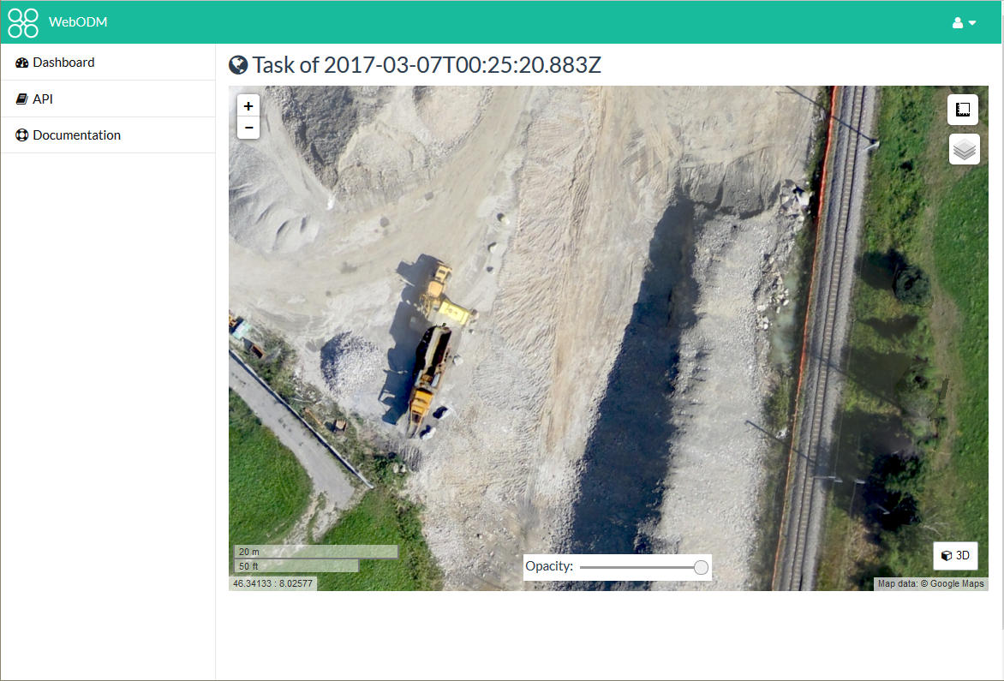

Slide 33
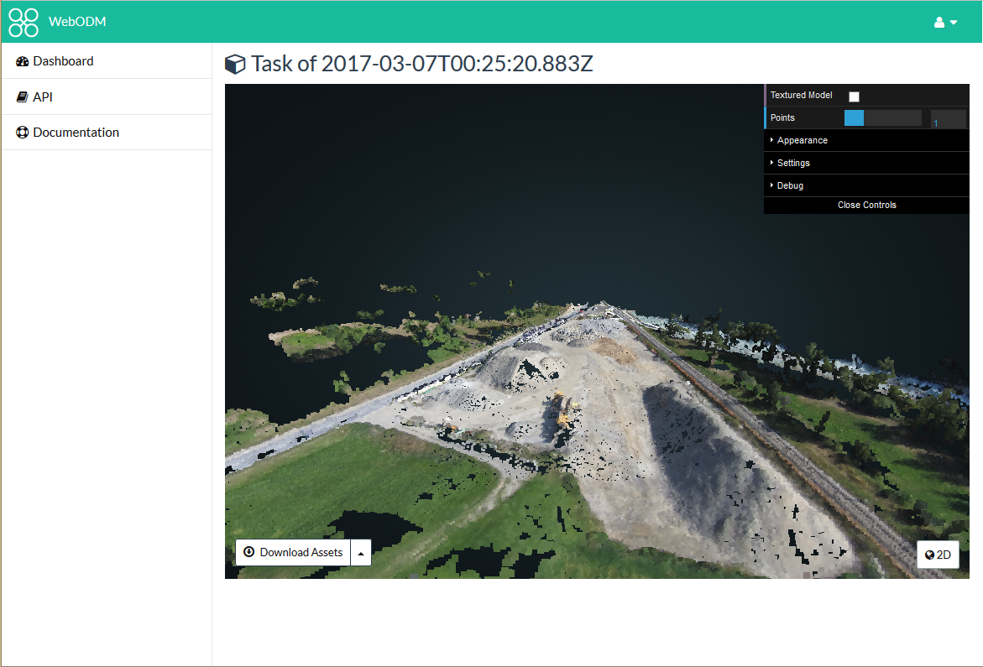

Slide 34
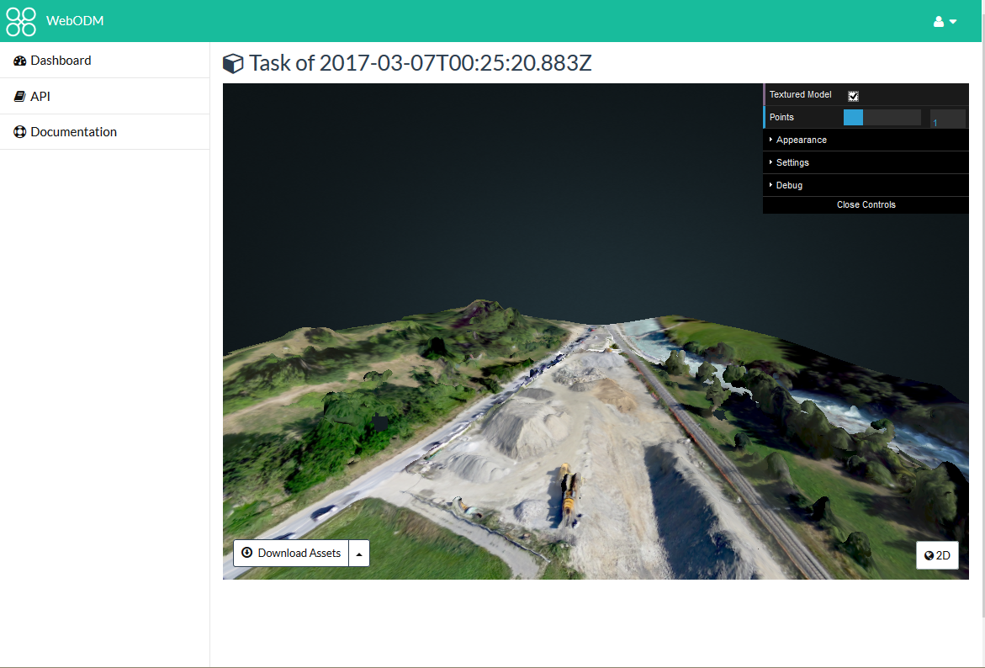

Slide 35
Funding and Future

Slide 36
Funding
Cleveland Metroparks
American Red Cross
Integration with Portable OpenStreetMap (POSM)
Humanitarian Innovation Fund
Make ODM Easier to Use
Make the products from it better / more accurate

Slide 37
OpenDroneMap: Future
Quality and robustness improvements
Scalability
Reduce memory footprint
Data Partitioning
Analysis
Add automated DTM extraction
Classification
Mesh improvements

Slide 38
DTM Extraction
Near future

Slide 39
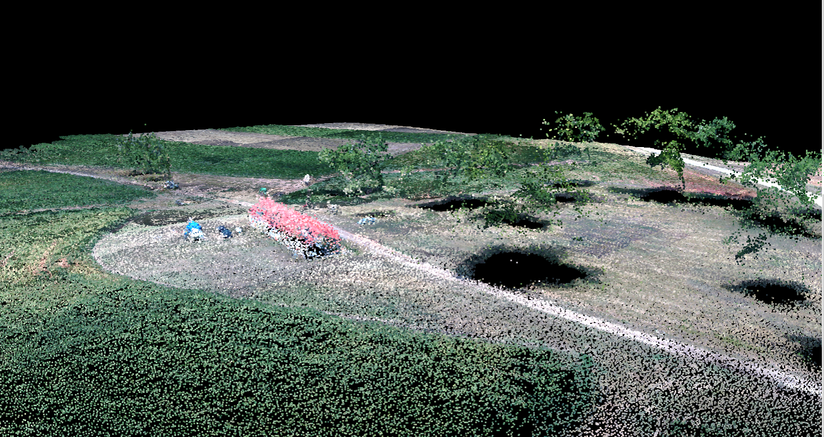
Midpines, flown by NextGen Air Transportation Center (NGAT) access to the data through collaboration with Center for Geospatial Analytics at NCSU

Slide 40
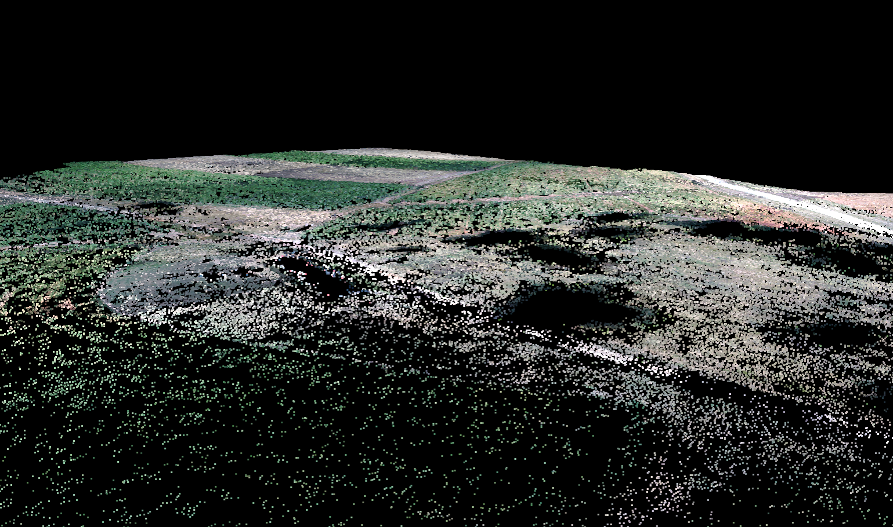
Midpines, flown by NextGen Air Transportation Center (NGAT) access to the data through collaboration with Center for Geospatial Analytics at NCSU

Slide 41
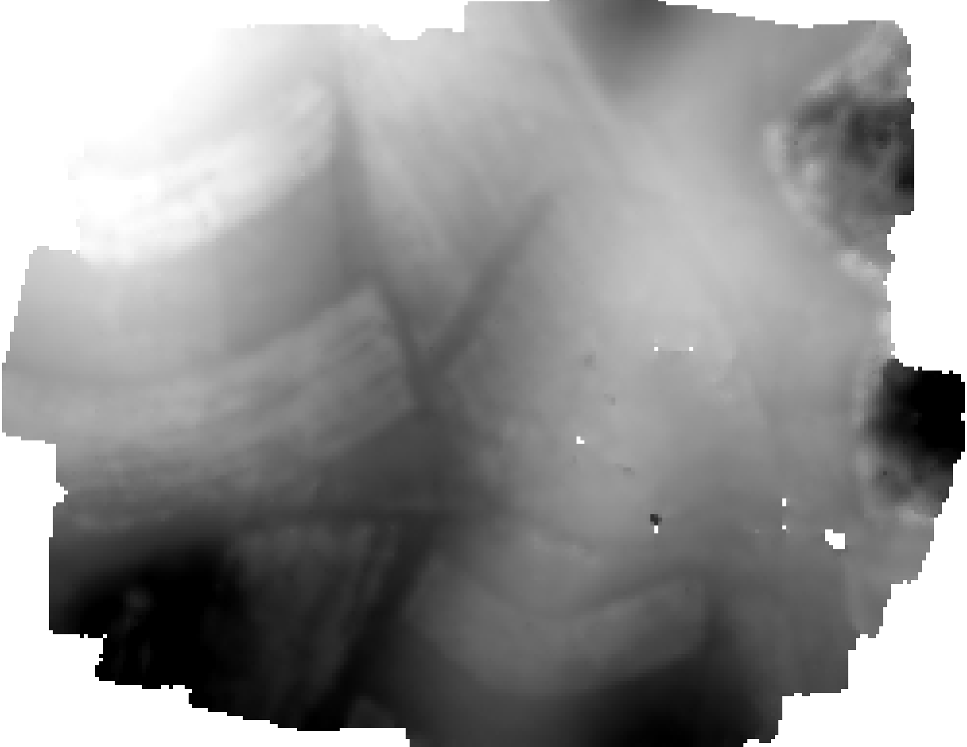
Midpines, flown by NextGen Air Transportation Center (NGAT) access to the data through collaboration with Center for Geospatial Analytics at NCSU

Slide 42
Near-term improvements
Quality reporting and robustness improvements
Incremental optimizations
Large-scale pipeline

Slide 43
Quality reporting and robustness improvements
Add reporting system to OpenSfM
Collect metadata on Structure from Motion Process
Number of matches, Matching graph between images, Number of reconstructed images and points, Histogram of reprojection errors, Memory Usage, etc.
Improve Robustness
Analyze and classify failures
Improve results on difficult datasets
Establish test datasets for ongoing testing

Slide 44
Large-scale pipelineor breaking datasets into bite-size pieces
Split large numbers of images into smaller groups
Run OpenSfM reconstruction on each subgroup
Align and transform those groups to each other using matching features between the groups

Slide 45
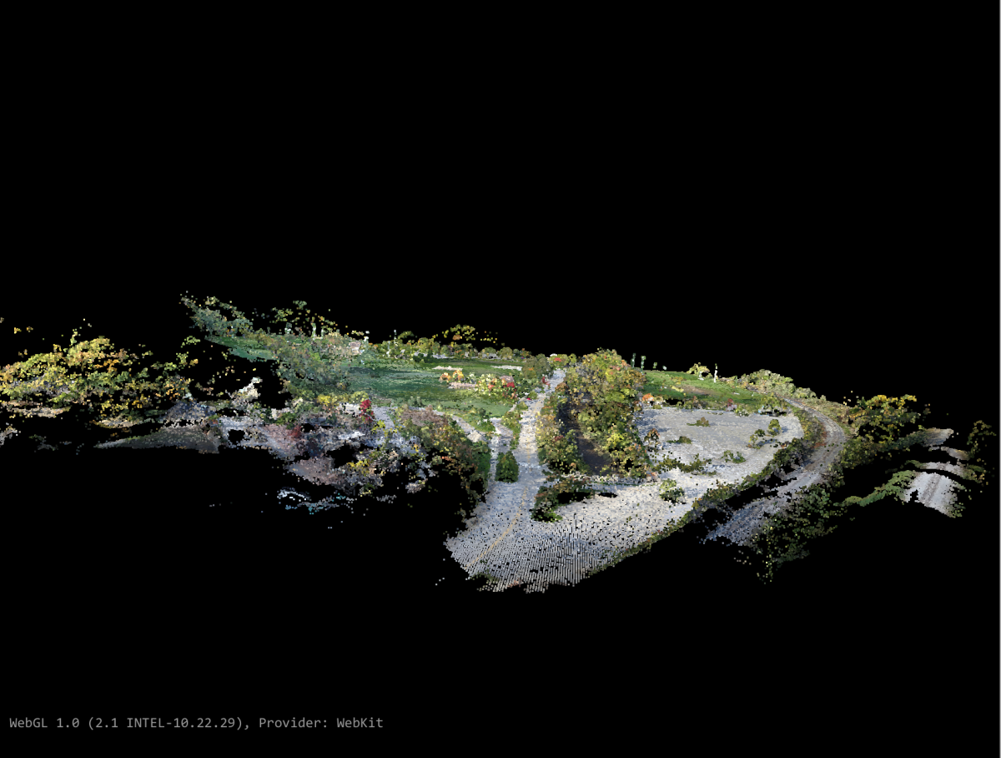
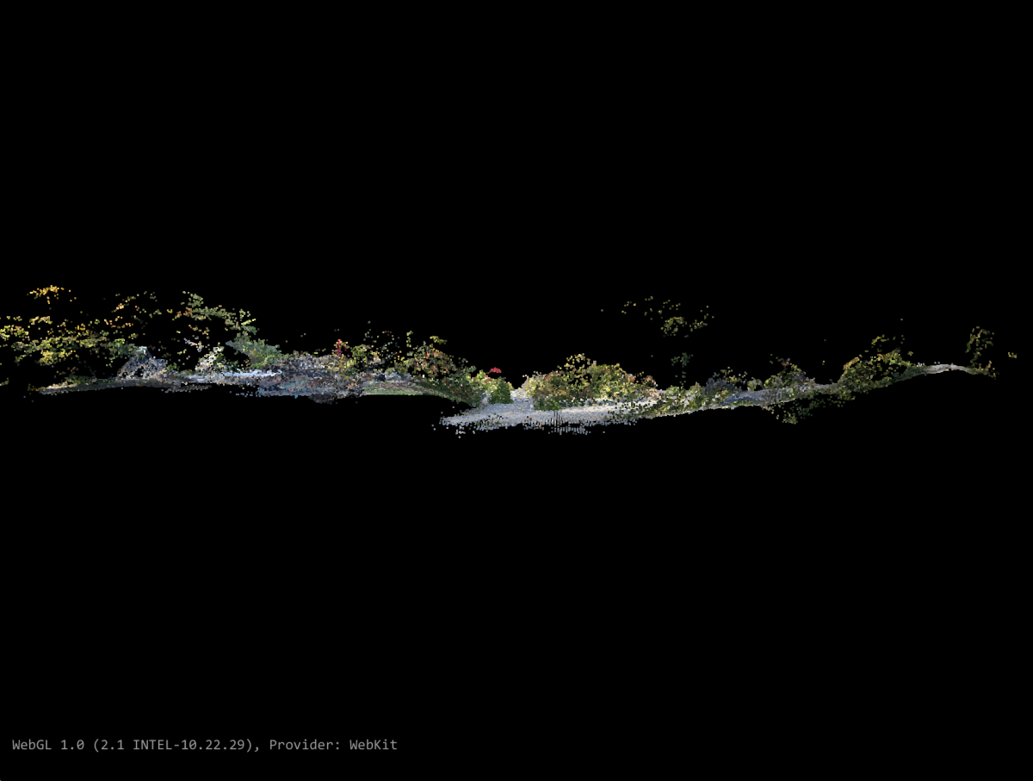
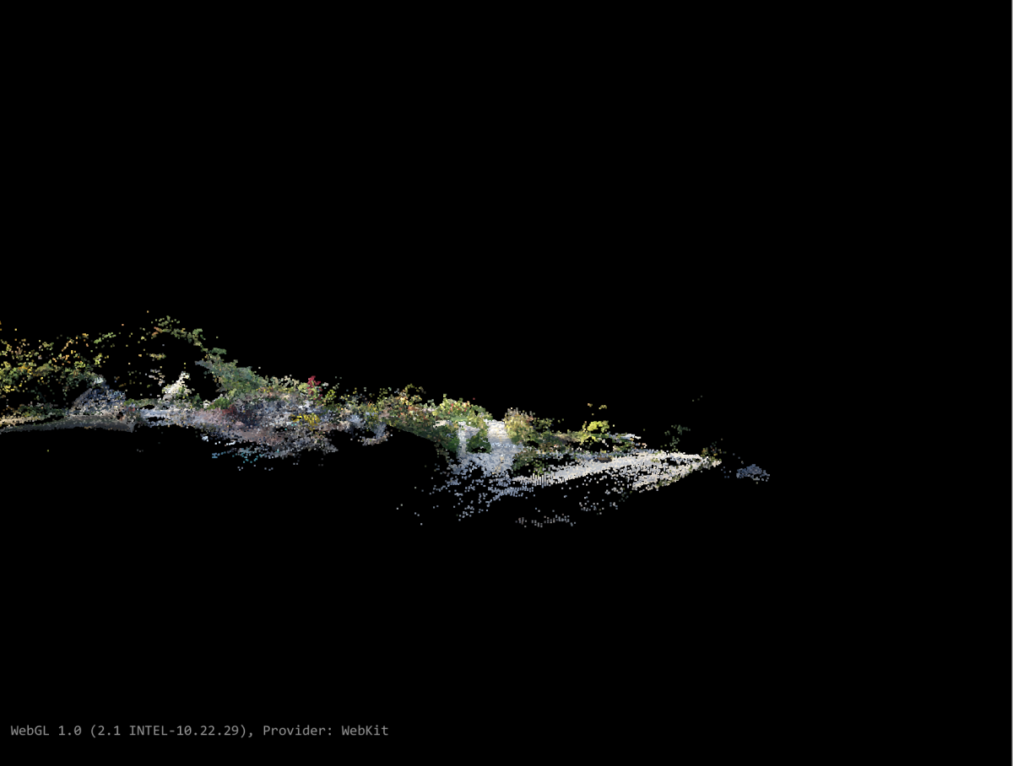
Large-scale pipelineor breaking datasets into bite-size pieces

Slide 46
Incremental optimizations or what happens after it’s down the gullet
Improve processor use
Cascade Hashing¹ matching
or
Bag of Words²
Improved Memory Use:
Improved correspondence graph data structures
SLAM-like pose-graph methods for global adjustment of camera position
[1] Jian Cheng, Cong Leng, Jiaxiang Wu, Hainan Cui, Hanqing Lu; The IEEE Conference on Computer Vision and Pattern Recognition (CVPR), 2014, pp. 1-8
[2] Michal Havlena, Konrad Schindler; VocMatch: Efficient Multiview Correspondence for Structure from Motion; Institute of Geodesy and Photogrammetry, ETH Zurich, Switzerland

Slide 47
WebODM: Future
DEM display
Volumetric Measurements
Mission Planning
Mobile App for autonomous flight
QGIS integration
Integration with Entwine + Greyhound
Integration with OpenAerialMap

Slide 48
Stephen Mather, GIS Manager, Cleveland Metroparks
@smathermather, svm@clevelandmetroparks.com
Dakota Benjamin, Geospatial Developer, Cleveland Metroparks
dmb2@clevelandmetroparks.com
http://tinyurl.com/odm-inaware

Slide 49
Outline
Introduction to OpenDroneMap
Break
Using OpenDroneMap
Break
Using Data from OpenDroneMap
http://tinyurl.com/odm-inaware

Slide 50
Outline
Using OpenDroneMap
Command-line use
Docker Use
WebODM Use
http://tinyurl.com/odm-inaware

Slide 51
Installation Instructions
https://github.com/OpenDroneMap/OpenDroneMap

Slide 52
Installation and Command-line Use
Download the latest release:
https://github.com/OpenDroneMap/OpenDroneMap/releases
Extract and enter the OpenDroneMap directory
Run bash configure.sh
Download and extract a sample dataset:
https://github.com/OpenDroneMap/odm_data_aukerman/archive/master.zip
Run ./run.sh --project-path <PATH>, replacing <PATH> with the dataset path.

Slide 53
Docker Use
cd directory_path
docker run -it --rm -v $(pwd)/images:/code/images /
-v $(pwd)/odm_orthophoto:/code/odm_orthophoto /
-v $(pwd)/odm_texturing:/code/odm_texturing /
opendronemap/opendronemap

Slide 54
Stephen Mather, GIS Manager, Cleveland Metroparks
@smathermather, svm@clevelandmetroparks.com
Dakota Benjamin, Geospatial Developer, Cleveland Metroparks
dmb2@clevelandmetroparks.com
http://tinyurl.com/odm-inaware

Slide 55
Outline
Introduction to OpenDroneMap
Break
Using OpenDroneMap
Break
Using Data from OpenDroneMap
http://tinyurl.com/odm-inaware

Slide 56
Outline
Using Data from OpenDroneMap
Downloading assets
Loading in QGIS
Loading in meshlab
Loading in pdal.io
http://tinyurl.com/odm-inaware

Slide 57
Stephen Mather, GIS Manager, Cleveland Metroparks
@smathermather, svm@clevelandmetroparks.com
Dakota Benjamin, Geospatial Developer, Cleveland Metroparks
dmb2@clevelandmetroparks.com
http://tinyurl.com/odm-inaware

